Slide 1


NLP Processing in Customers Reviews | project
GROUP Members :
Arwa , Malak , sarah

Slide 2

NLP Processing in Customers Reviews | project
GROUP Members :
Arwa , Malak , sarah

Slide 3

Problem Statement
Manually analyzing reviews is inefficient and
subjective.
Our goal is to automate review classification,
clustering, and summarization using NLP.

Slide 4


Problem Statement
Project Goals
1
Classify reviews into sentiment categories.
4
Deploy the full pipeline as an interactive
tool.
2
3
Group reviews into product categories.
Generate summaries with
recommendations.
Manually analyzing reviews is inefficient and
subjective.
Our goal is to automate review classification,
clustering, and summarization using NLP.

Slide 5






Metheodology
Deployment
Data Collection
Sentiment Classification
Data Preprocessing
Insights Extraction
Manually analyzing reviews is inefficient and
subjective.
Our goal is to automate review classification,
clustering, and summarization using NLP.

Slide 6
Data Preprocessing
Insights Extraction
Data Collection
Tools and Technologies
• Python, Google Colab
• Transformers (Hugging Face)
• Scikit-learn, Matplotlib, Seaborn
• Gradio,Flan-T5-Base (Google )
Deployment
Manually analyzing reviews is inefficient and
subjective.
Our goal is to automate review classification,
clustering, and summarization using NLP.
Sentiment Classification

Slide 7


Data Preprocessing
Insights Extraction
Data Preprocessing
Data Collection
• Cleaned and filtered over 34,000 Amazon reviews
• Removed URLs, special characters, and lowercased text
• Labeled sentiments based on star ratings:
– 1–2 stars → Negative
– 3 stars → Neutral
– 4–5 stars → Positive
Deployment
Manually analyzing reviews is inefficient and
subjective.
Our goal is to automate review classification,
clustering, and summarization using NLP.
Sentiment Classification

Slide 8
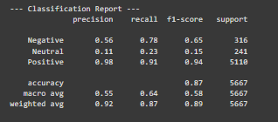

Data Preprocessing
Insights Extraction
Sentiment Classification
Data Collection
• Model: Twitter-RoBERTa-base
• Achieved Accuracy: 87% on the test set
• Evaluation metrics used:
– Precision
– Recall
– F1-score
– Confusion Matrix
• Highest performance on Positive class (F1-score = 0.94)
• Neutral class was the most challenging (F1-score = 0.15)
Deployment
Manually analyzing reviews is inefficient and
subjective.
Our goal is to automate review classification,
clustering, and summarization using NLP.
Sentiment Classification

Slide 9
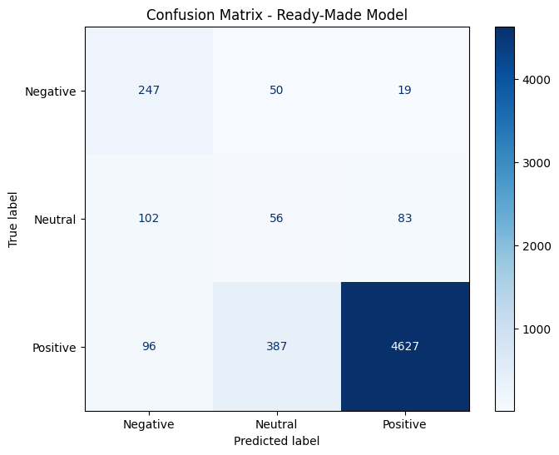


Data Preprocessing
Insights Extraction
Confusion Matrix
Data Collection
Deployment
Manually analyzing reviews is inefficient and
subjective.
Our goal is to automate review classification,
clustering, and summarization using NLP.
Sentiment Classification

Slide 10

Data Preprocessing
Insights Extraction
Product Clustering
Data Collection
Deployment
• Feature extraction using TF-IDF & Sentence-BERT
• K-Means clustering with k = 5
• Categories matched business product types
• Validated using silhouette score & manual labeling
Manually analyzing reviews is inefficient and
subjective.
Our goal is to automate review classification,
clustering, and summarization using NLP.
Sentiment Classification

Slide 11

Data Preprocessing
Insights Extraction
Review Summarization
Data Collection
• Used Flan-T5-Base model for generating summaries
• Highlighted pros and cons per product cluster
• Helped reduce manual review effort by ~70%
• Example: Tablets praised for battery life, criticized for screen quality
Deployment
Manually analyzing reviews is inefficient and
subjective.
Our goal is to automate review classification,
clustering, and summarization using NLP.
Sentiment Classification

Slide 12


Data Preprocessing
Insights Extraction
Results & Evaluation
Data Collection
• Accuracy: 87%, F1-score: 0.89
• Clear sentiment classification across classes
• Meaningful summaries for each product cluster
• Simple and interactive Gradio interface
Deployment
Manually analyzing reviews is inefficient and
subjective.
Our goal is to automate review classification,
clustering, and summarization using NLP.
Sentiment Classification

Slide 13
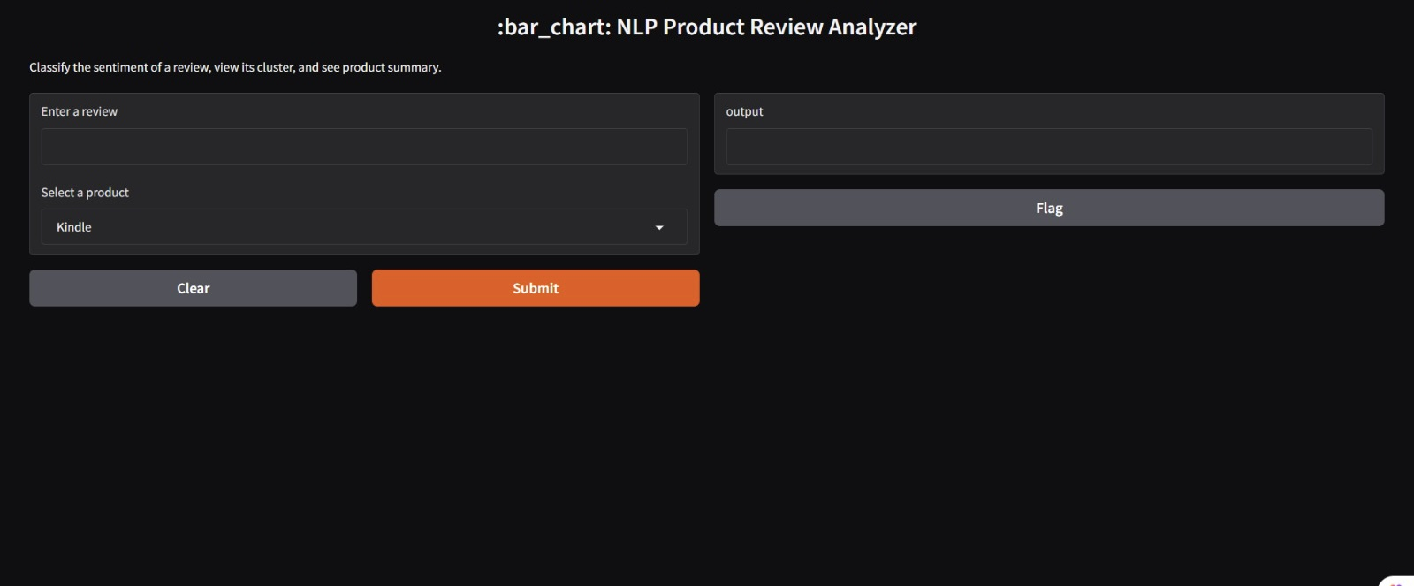
Data Preprocessing
Insights Extraction
Deployment.
Data Collection
• Interactive web app using Gradio
• Input review → instant sentiment, cluster & summary
Deployment
Manually analyzing reviews is inefficient and
subjective.
Our goal is to automate review classification,
clustering, and summarization using NLP.
Sentiment Classification

Slide 14


Data Preprocessing
Insights Extraction
Challenges & Future Improvements
Data Collection
• Difficulty in classifying neutral sentiment accurately
• Limited dataset diversity affected some clusters
• Plan to fine-tune RoBERTa and Flan-T5 for better results
• Expand dataset to improve coverage and model performance
Deployment
Manually analyzing reviews is inefficient and
subjective.
Our goal is to automate review classification,
clustering, and summarization using NLP.
Sentiment Classification

Slide 15
Data Preprocessing
Insights Extraction
Data Collection
THANK YOU
Deployment
ANY QUESTION ?
Manually analyzing reviews is inefficient and
subjective.
Our goal is to automate review classification,
clustering, and summarization using NLP.
Sentiment Classification

